Slide 1

Tales Time Bookings
Submitted By
1. Nithin
2. Amana
3. Faiz
4. Musthak
5. Mishal

Slide 2
INDRODUCTION
Users can access site from anywhere to get detail about the theatres in Ernakulam, Calicut, Trivandrum.
Theaters are classified based on districts and the theatre detail including the address is provided in the site.
OTT release updates of Malayalam movies in current month is provided
Movies will be listed and can book the show by clicking on the time they needed and they are directed to the theatres official site.
Movie trailers are provided in the form of youtube link

Slide 3
SCHEDULE
HOME PAGE
OTT UPDATES,COMING SOON & ABOUT
DISTRICT PAGE
BOOKING PAGE
07-07-2022
13-07-2022
21-07-2022
25-07-2022

Slide 4
Work Division
Booking page including movie details : Amana
Basic Information of movies based on district page & Coming Soon : Nithin A
Home Page : Muthak K & Nithin
About & OTT Updates : Mishal
Final Edits : Amana K

Slide 5
SITE MAP
HOME
CALICUT
ERNAKULAM
TRIVANDRUM
ABOUT
COMING SOON
OTT UPDATES
DISTRICT PAGE
DISTRICT PAGE
DISTRICT PAGE
BOOKING
PAGE
BOOKING
PAGE
BOOKING PAGE

Slide 6
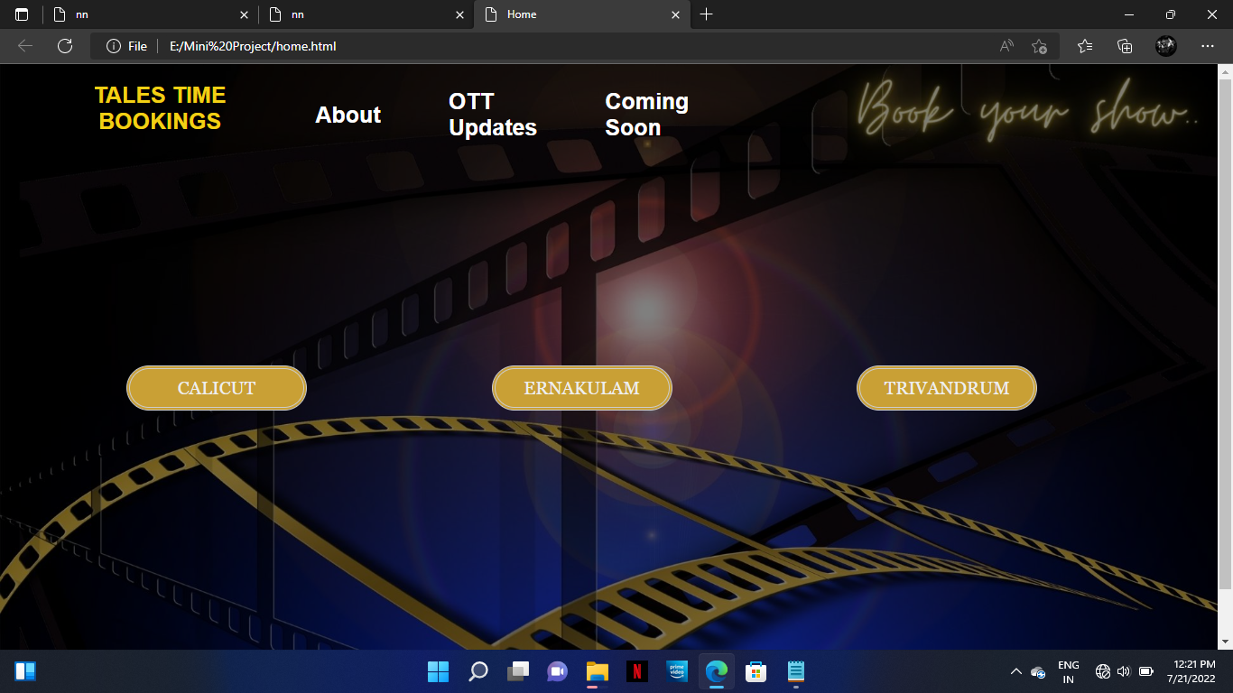
Outputs
HOME PAGE

Slide 7
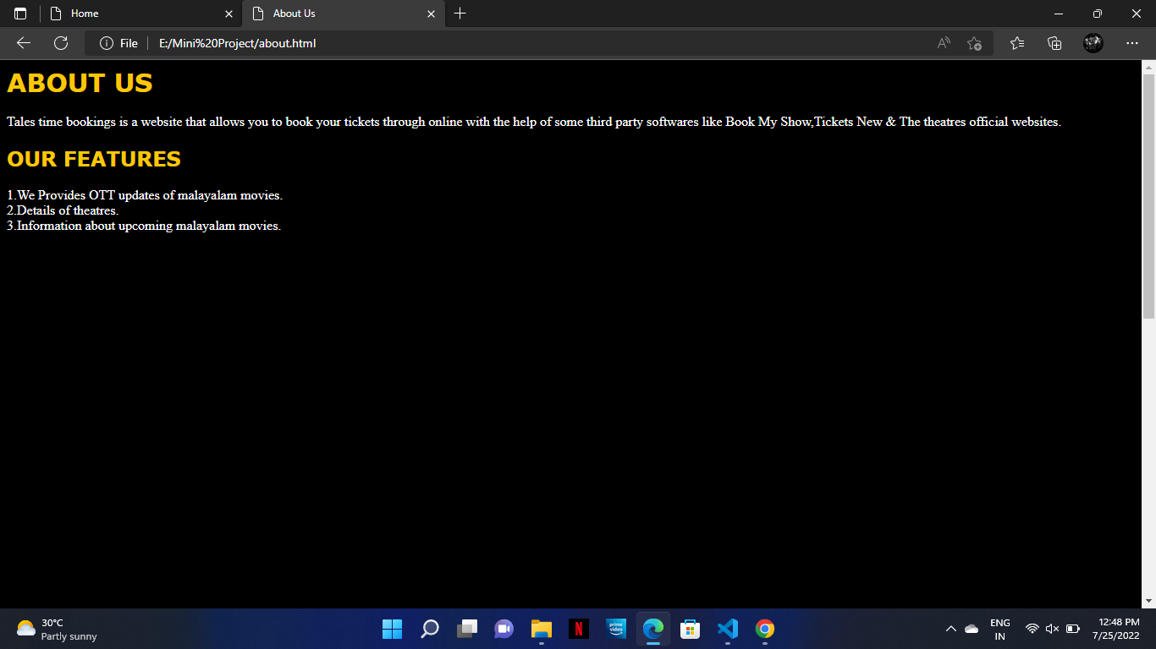

Slide 8
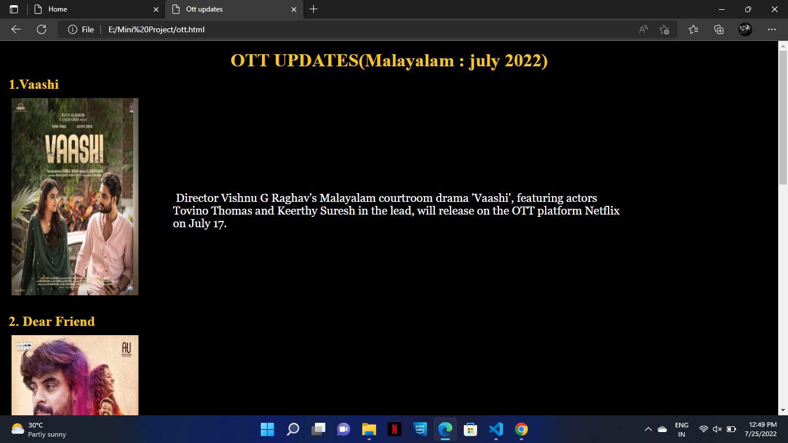
OTT UPDATES
In this page we provides the details of upcoming Malayalam movies which streams in ott platforms like Netflix, Amazon prime, Sony liv, Zee5 etc

Slide 9
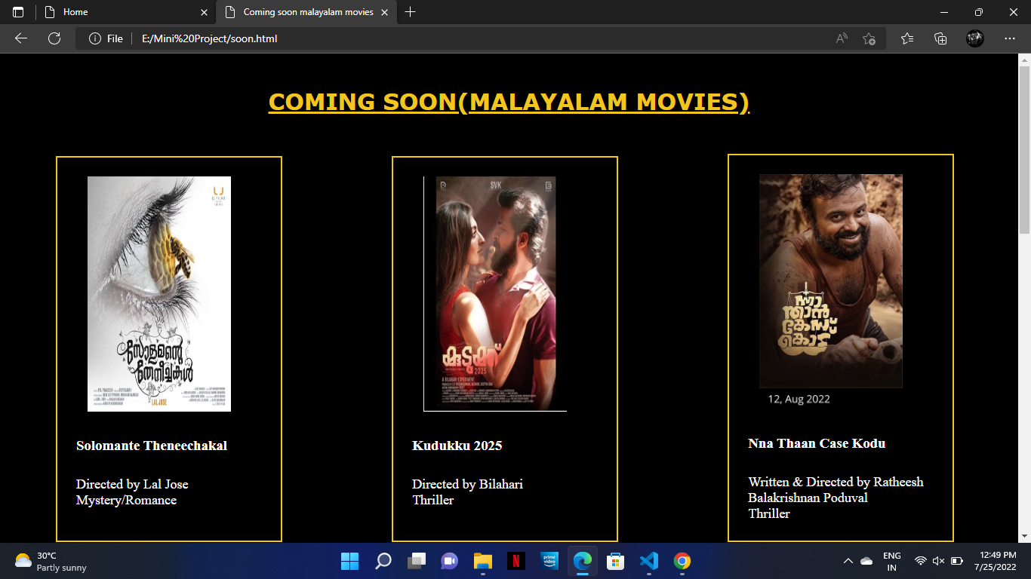
COMING SOON
In this page we provides specific details of upcoming Malayalam movie in theatres. By clicking on them user will get redirected to trailer of the movie throw youtube

Slide 10
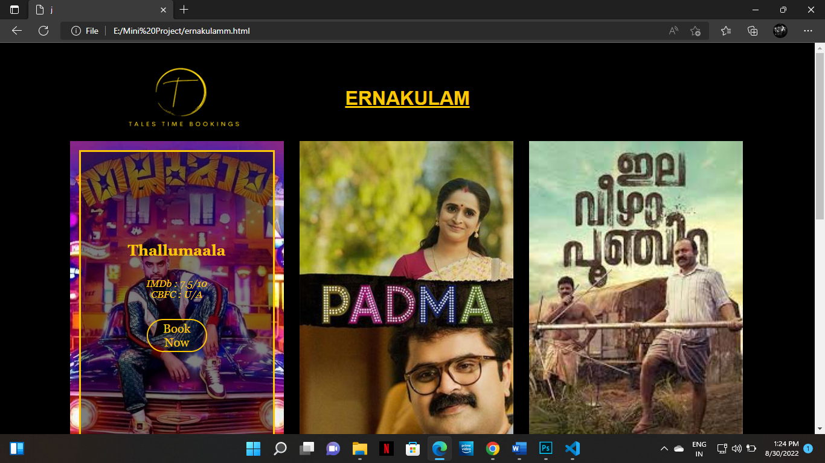

Slide 11
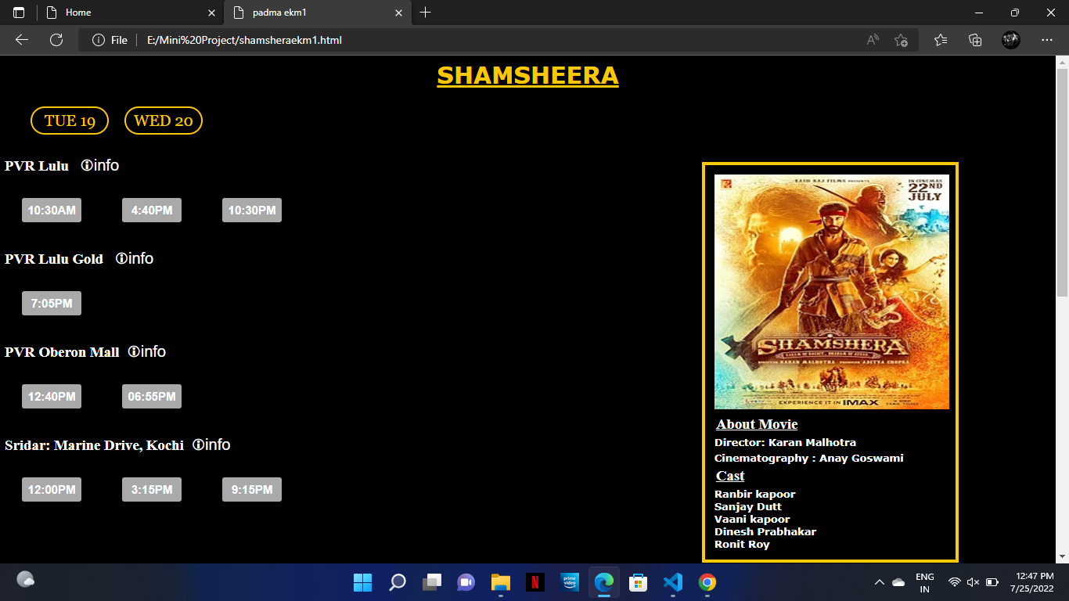
On clicking this button user can get the address of theatre
User can select their convenient time throw these buttons

Slide 12
CONCLUSION
Here by we are concluding our project presentation.
In this project we created a website that can be used to book movie tickets.
We have used HTML , CSS, & Javascript to create website.

Slide 13
REFERENCES
www.google.com
www.youtube.com

Slide 14
THANK YOU

